Slide 1
数 据 库 原 理
Chp 2
Introduction to Relational Model
王 建 民
清 华 大 学 软 件 学 院
2023年/春

Slide 2

关系数据库
Relational Databases
  A relational database consists of a collection of tables

Slide 3
Department Table
How to model the table with mathematics?
Relation

Slide 4
Main Contents
关系模型
关系代数基础
小结

Slide 5
Relation
Domain
  the set of permitted values with the same type
  The special value null(空值) is a member of every domain， means ‘unknown’ or ‘does not exist’
given sets D₁, D₂, …. D_{n,} a relation r is a subset of D₁ x D₂ x … x D_{n}
  Thus a relation is a set of n-tuples (a₁, a₂, …, a_{n}) where a_{i} ∈ D_{i}
  n is called arity (中文’元‘)，
  n-tuple 即 n元组
Notes:
The values of a attribute has the same type
Different attributes may belong to the same domain

Slide 6
Example of Relation
dept-name = {Biology, Finance, History, Music, Physics}
building = {Watson, Painter, Packard}
budget = {90000, 120000, 70000, 80000}
Then r = { (Biology, Watson, 90000),
(Finance, Painter, 120000),
(Music, Packard, 80000),
(Physics, Watson, 70000)}
is a relation over dept-name x building x budget

Slide 7
Tuple & Tuple Variable
An element of relation r is a tuple, represents a row in a table
A tuple variable t stands for a tuple
  t[dept-name] denotes the value of t on the dept-name attribute
  t[1] denotes value the first attribute of t(viz. positional notation)
A relation is a set of tuples with the same type

Slide 8
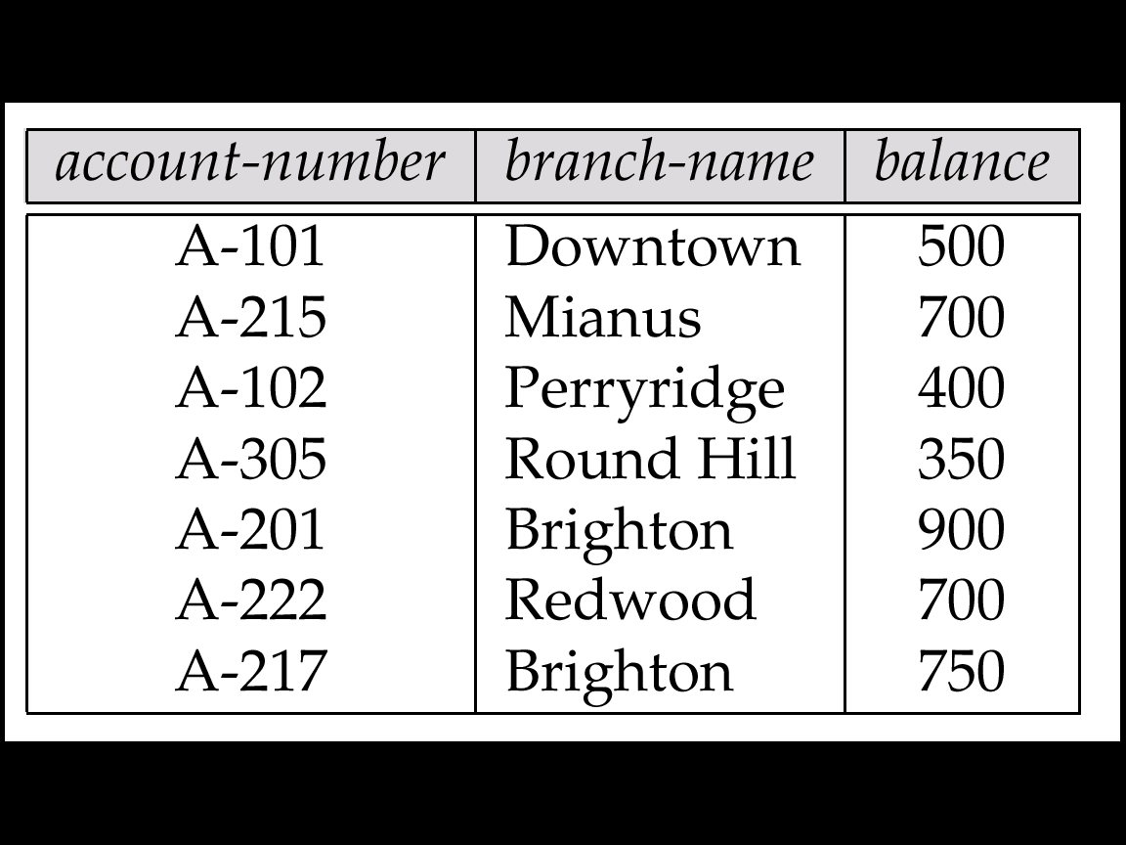

Relations are Unordered
tuples are irrelevant
  Tuples may be stored in an arbitrary order
E.g. account relation with unordered tuples
Notes:
Content-base loaction

Slide 9
Relation Schema
R (A₁, A₂, …, A_{n} ) is a relation schema
E.g. Department-schema
(dept-name,
building,
budget)
r(R) is a relation instance of relation schema R
  E.g. deptartment (Department-schema)
Notes:
Relation schema is the relation type definition

Slide 10
Schema and Instance
Relation Schema
  account(a-number, b-name, balance)
Relation Instance
《——》
Data Type
  Integer
《——》
Value
  123
The value of a given variable may change with time; similarly the contents of a relation instance may change with time as the relation is updated.

Slide 11
Superkey
Let K ⊆ R
K is a superkey of R if values for K are sufficient to identify a unique tuple of each possible relation r(R)
Example: {customer-name, customer-street} and
{customer-name}
are both superkeys of Customer, if no two customers can possibly have the same name

Slide 12
Candidate Key & Primary Key
K is a candidate key if K is minimal
  {customer-name} is a candidate key for Customer
Although several candidate keys may exist, one of the candidate keys is selected to be the primary key
  The attributes of the primary key is called prime attributes(主属性)

Slide 13
Account Table
Superkey，Candidate Key ， Primary Key?

Slide 14
Foreign Key
Let r1(R1) and r2(R2) be relations with primary keys K1 and K2 respectively，
  - The subset α of R2 is a foreign key referencing K1 in relation r1，
  For every t2 in r2 there must be a tuple t1 in r1 such that t1[K1] = t2[α]
  r2 is called the referencing relation of the foreign key dependency, and r1 is called the referenced relation of the foreign key

Slide 15
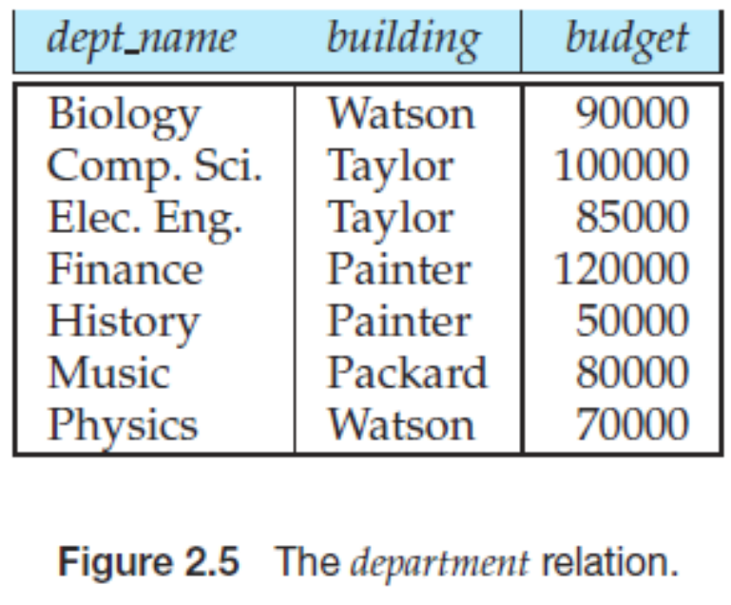
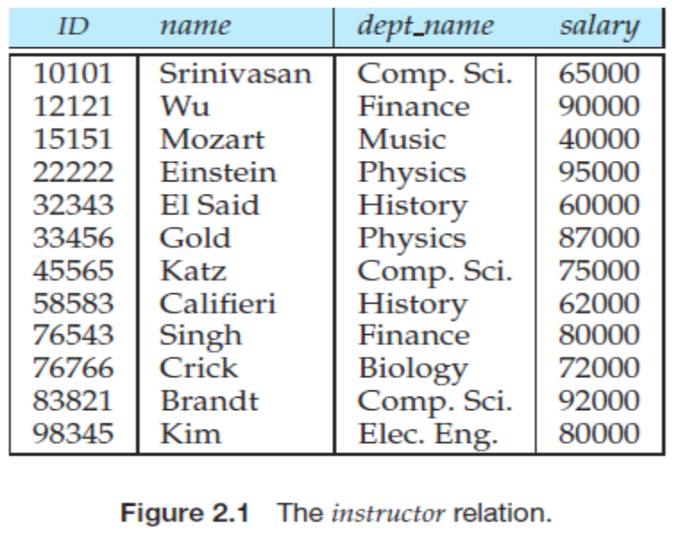
Foreign Key Example
department (dept_name, building, budget)
instructor(ID, name, dept_name, salary)
  -dept_name in instructor is a foreign key from instructor referencing department
Which is the referenced relation of this foreign key ?

Slide 16

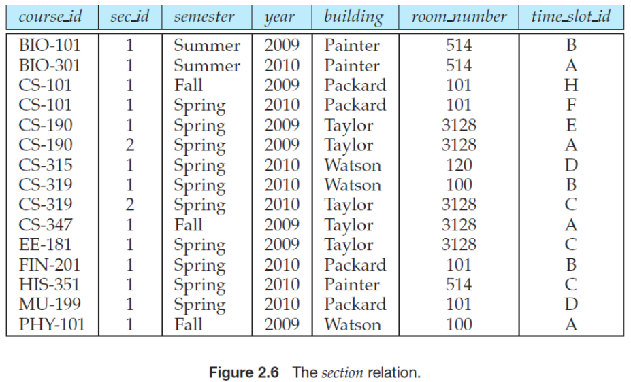
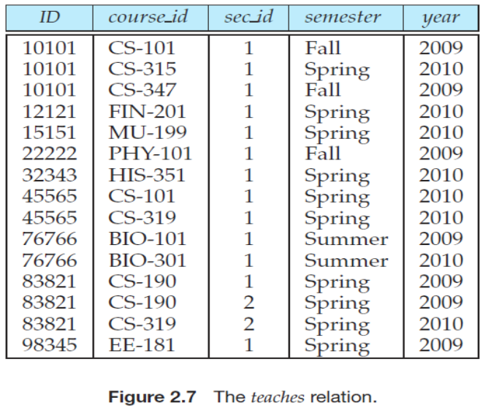
单选题
答案解析
2分
答案解析
section (course_id, sec_id, semester, year, building, room number, time slot id)
teaches (ID,
course_id, sec_id, semester, year)
错。虽然每个课堂（section）都要有老师教，但是课堂复合主键（ course_id, sec_id, semester, year ）不是teaches关系的主键，注意teaches的主键是所有属性，因此根据外键约束的定义，这四个属性不是从关系section到关系teaches的外键。反之成立吗？
(course_id, sec_id, semester, year) in section
is a foreign key from section referencing teaches
A
对
B
错
提交
可为此题添加文本、图片、公式等解析，且需将内容全部放在本区域内。正常使用需3.0以上版本

Slide 17
Relational Database
A database schema consists of a set of relation schemas
A database instance consists of a set of relations
In relational database, information about an enterprise is broken up into parts, with each relation storing one part of the information
E.g.
account : stores information about accounts
depositor : stores information about which customer owns which account
  customer : stores information about customers

Slide 18

Schema Diagram for University Database

Slide 19
Schema of the University Database
classroom(building, room_number, capacity)
department(dept_name, building, budget)
course(course_id, title, dept_name, credits)
instructor(ID, name, dept_name, salary)
section(course_id, sec_id, semester, year, building, room number, time_slot_id)
teaches(ID, course_id, sec_id, semester, year)
student(ID, name, dept_name, tot_cred)
takes(ID, course_id, sec_id, semester, year, grade)
advisor(s_ID, i_ID)
Time_slot(time_slot_id, day, start_time, end_time)
prereq(course_id, prereq_id)

Slide 20
Basic Concepts
Domain (域) , Relation (关系), Attribute(属性), Tuple(元组)
Superkey(码) , Candidate Key(候选码), Primary Key (主码)
Relation Schema (关系模式),
Relation (instance) (关系实例) ,
Relational Database (关系数据库)

Slide 21
Main Contents
关系模型
关系代数基础
小结

Slide 22
Query Language
A language in which a user specify the query from the database
Procedural Language
  A sequence of operations
  Relational algebra
Non-Procedural Language
  Description of the desired information
  Relational calculus

Slide 23
What is Relational Algebra?
集合＋运算＝代数系统
Relations ＋ Operators ＝ Relational algebra
  The operators take one or more relations as inputs and give a new relation as a result
Relation algebra can be used as a query language for relations

Slide 24
6 Basic Operators
  Union （并）
  set difference （差）
  Cartesian product （笛卡尔积）
  Select （选择）
  Project （投影）
  Rename （换名）

Slide 25
Union Operation
Notation: r ∪ s
Defined as
r ∪ s = {t | t ∈ r or t ∈ s}
For r ∪ s to be valid
  r, s must have the same arity (same number of attributes)
  The attribute domains must be compatible (e.g., 2nd column of r deals with the same type of values as does the 2nd column of s)

Slide 26
Union – Example
A
B
A
B
Relations r, s:
α
α
β
1
2
1
α
β
2
3
s
r
r ∪ s:
A
B
α
α
β
β
1
2
1
3

Slide 27
Set Difference Operation
Notation r – s
Defined as:
r – s = {t | t ∈ r and t ∉ s}
Set differences must be taken between compatible relations
  r and s must have the same arity
  attribute domains of r and s must be compatible

Slide 28
Set Difference – Example
Relations r, s:
A
B
A
B
α
α
β
1
2
1
α
β
2
3
s
r
r – s:
A
B
α
β
1
1

Slide 29
Cartesian-Product Operation
Notation r x s
Defined as:
r x s = {t q | t ∈ r and q ∈ s}
  Assume that attributes of r(R) and s(S) are disjoint. (That is, R ∩ S = ∅)
  If attributes of r(R) and s(S) are not disjoint, then renaming must be used

Slide 30
Cartesian-Product - Example
A
B
C
D
E
Relations r, s:
α
β
1
2
α
β
β
γ
10
10
20
10
a
a
b
b
r
s
r x s:
A
B
C
D
E
α
α
α
α
β
β
β
β
1
1
1
1
2
2
2
2
α
β
β
γ
α
β
β
γ
10
10
20
10
10
10
20
10
a
a
b
b
a
a
b
b

Slide 31
Select Operation
Notation: σ _{p}(r)
p is called the selection predicate(选择谓词)
Defined as:
σ_{p}(r) = {t | t ∈ r and p(t)}
  Where p is a formula in propositional calculus(命题逻辑) consisting of terms connected by
  ∧ (and), ∨ (or), ¬ (not)
  Each term is one of
<attribute>op <attribute> or <constant>
  where op is one of: =, ≠, >, ≥, <, ≤

Slide 32
Select – Example
Relation r
A
B
C
D
α
α
β
β
α
β
β
β
1
5
12
23
7
7
3
10
σ_{A=B ^ D > 5} (r)
A
B
C
D
α
β
α
β
1
23
7
10

Slide 33
Project Operation
Notation:
∏_{A1, A2, …, Ak} (r)
where A₁, A₂ are attribute names and r is a relation
  The result is defined as the relation of k columns obtained by erasing the columns that are not listed
  Duplicate rows removed from result, since relations are sets

Slide 34
Project – Example
A
B
C
Relation r:
α
α
β
β
10
20
30
40
1
1
1
2
∏_{A,C} (r)
A
C
A
C
α
α
β
β
1
1
1
2
α
β
β
1
1
2
=

Slide 35
Rename Operation（课本上没有）
Notation:
ρ _{x} (E)
returns the result of expression E under the name X
If a relational-algebra expression E has arity n, then
ρ_{x} _{(A1, A2, …, An)} (E)
returns the result of expression E under the name X, and with the attributes renamed to A1, A2, …., An

Slide 36
Rename Example
Allows us to name, and therefore to refer to, the results of relational-algebra expressions
  Let E is a relational algebra expressions
  ρ _{X}(E) return the result relation of E as X relation
When the Cartesian product of a relation with itself is desired
  Let r1 is relation on the relation schema R1(son,father)
  ∏ _{r1.father,r2.son} (σ _{r1.son=r2.father}(r1X ρ _{r2}(r1) ))

Slide 37
Relational Algebra Expression
A relation in the database is a Relational Algebra Expression
A constant relation is a Relational Algebra Expression
  {(A-101, Downtown, 500) (A-215, Mianus, 700)},

Slide 38
Relational Algebra Expression(c1)
Let E₁ and E₂ be relational-algebra expressions; the following are all relational-algebra expressions:
  （并）E₁ ∪ E₂
  （差） E₁ - E₂
  （笛卡尔积）E₁ x E₂
  （选择）σ_{p} (E₁), P is a predicate on attributes in E₁
  （投影） ∏_{s}(E₁), S is a list consisting of some of the attributes in E₁
  （换名） ρ _{x} (E₁), x is the new name for the result of E₁

Slide 39
Example 1: σ_{A=C}(r x s)
r x s
σ_{A=C}(r x s)
A
B
C
D
E
A
B
C
D
E
α
β
1
2
α
β
β
γ
10
10
20
10
a
a
b
b
α
α
α
α
β
β
β
β
1
1
1
1
2
2
2
2
α
β
β
γ
α
β
β
γ
10
19
20
10
10
10
20
10
a
a
b
b
a
a
b
b
r
s
A
B
C
D
E
α
β
β
1
2
2
α
β
β
10
10
20
a
a
b

Slide 40
Example 2: Natural Join
Let r and s be relations on schemas R and S respectively.
Then, the “natural join” of relations R and S is a relation on schema R ∪ S obtained as follows:
  Consider each pair of tuples t_{r} from r and t_{s} from s.
  If t_{r} and t_{s} have the same value on each of the attributes in R ∩ S, add a tuple t to the result, where
    t has the same value as t_{r} on r
    t has the same value as t_{s} on s

Slide 41

Natural Join Example
Relations r, s:
Natural Join
  r s
∏ _{A, r.B, C, r.D, E} (σ _{r.B = s.B ˄ r.D = s.D} (r x s)))
为什么自然连接 不算关系代数的6个基本操作？

Slide 42
Example 2: Natural Join
Let r and s be relations on schemas R and S respectively.
Then, the “natural join” of relations R and S is a relation on schema R ∪ S obtained as follows:
  Consider each pair of tuples t_{r} from r and t_{s} from s.
  If t_{r} and t_{s} have the same value on each of the attributes in R ∩ S, add a tuple t to the result, where
    t has the same value as t_{r} on r
    t has the same value as t_{s} on s

Slide 43
Example 3：Bank Database
Branch 营业所
(branch-name, branch-city, assets)
Customer 客户
(customer-name, customer-street, customer-only)
Account 存款明细
(account-number, branch-name, balance)
loan 贷款明细
(loan-number, branch-name, amount)
depositor 存款
(customer-name, account-number)
borrower 贷款
(customer-name, loan-number)

Slide 44
Queries 1/2
1、Find the names of all customers who have a loan, an account, or both, from the bank
2、Find the names of all customers who have a loan and an account at bank

Slide 45
Queries 1/2
1、Find the names of all customers who have a loan, an account, or both, from the bank
2、Find the names of all customers who have a loan and an account at bank
  ∏_{customer-name} (borrower) ∪ ∏_{customer-name} (depositor)
∏_{customer-name} (borrower) ∩ ∏_{customer-name} (depositor)
∏_{customer-name} (borrower) —(∏_{customer-name} (borrower) — ∏_{customer-name} (depositor))

Slide 46
Queries 3/4
3、Find the names of all customers who have a loan at the Perryridge branch
4、Find the names of all customers who have a loan at the Perryridge branch but do not have an account at any branch of the bank

Slide 47
Queries 3/4
3、Find the names of all customers who have a loan at the Perryridge branch
4、Find the names of all customers who have a loan at the Perryridge branch but do not have an account at any branch of the bank
∏_{customer-name} (σ_{branch-name=“Perryridge”}
(σborrower.loan-number = loan.loan-number(borrower X loan)))
∏_{customer-name} (σ_{branch-name = “Perryridge”}
(σborrower.loan-number = loan.loan-number(borrower x loan)))
– ∏_{customer-name}(depositor)

Slide 48
Example 4：University Database
classroom(building, room_number, capacity)
department(dept_name, building, budget)
course(course_id, title, dept_name, credits)
instructor(ID, name, dept_name, salary)
section(course_id, sec_id, semester, year, building, room number, time_slot_id)
teaches(ID, course_id, sec_id, semester, year)
student(ID, name, dept_name, tot_cred)
takes(ID, course_id, sec_id, semester, year, grade)
advisor(s_ID, i_ID)
Time_slot(time_slot_id, day, start_time, end_time)
prereq(course_id, prereq_id)

Slide 49
Query
Find the largest salary in the university

Slide 50
Query
Find the largest salary in the university
  Step 1: find instructor salaries that are less than some other instructor salary (i.e. not maximum)
    ∏_{instructor.salary} (σ _{instructor.salary < d,salary}
    (instructor x ρ_{d} (instructor)))

Slide 51
Query
Find the largest salary in the university
  Step 1: find instructor salaries that are less than some other instructor salary (i.e. not maximum)
    ∏_{instructor.salary} (σ _{instructor.salary < d,salary}
    (instructor x ρ_{d} (instructor)))
  Step 2: Find the largest salary
    ∏_{salary} (instructor) –
    ∏_{instructor.salary} (σ _{instructor.salary < d,salary}
    (instructor x ρ_{d} (instructor)))

Slide 52
Main Contents
关系模型
关系代数基础
小结

Slide 53
Some Relational Algebra Operators
Symbol (Name) Example of Use
σ
(Selection) ^{σ} salary > = 85000 ^{(instructor)}
Return rows of the input relation that satisfy the predicate.
Π
(Projection) ^{Π} ID, salary ^{(instructor)}
Output specified attributes from all rows of the input relation. Remove duplicate tuples from the output.
x
(Cartesian Product) instructor x department
Output pairs of rows from the two input relations that have the same value on all attributes that have the same name.
∪
(Union) ^{Π} name ^{(instructor) ∪ Π} name ^{(student)}
Output the union of tuples from the two input relations.
-
(Set Difference) ^{Π} name ^{(instructor)} ^{-- Π} name ^{(student)}
Output the set difference of tuples from the two input relations.
ρ
ρ _{X}(E)
(Rename)
Return the result of expression E under the name x.
⋈
instructor ⋈ department
(Natural Join)
Output pairs of rows from the two input relations that have the same value on all attributes that have the same name.

Slide 54
本节课的内容
理论 | 核心知识点 | 对应章节
数据库理论 | 关系模型、关系代数、关系演算 | CHP. 2、6
数据库应用 | SQL语言、JDBC | CHP3、4、5
数据库设计 | 实体-联系图、关系范式 | CHP7、8
数据库实现 | 存贮、索引、查询、优化、 事务、并发、恢复 | CHP10、11、12、13、 14、15、16

